Slide 1



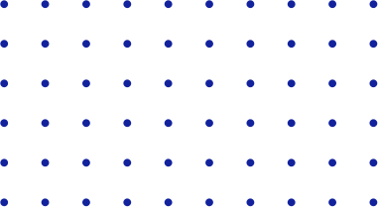


YOLO
Basic Terminologies
Part Three IoU and NMS

Slide 2




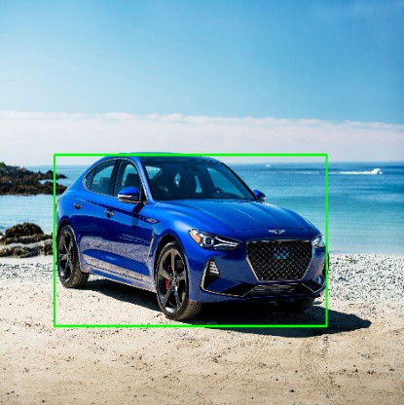


Bounding Box
A bounding box in essence, is a rectangle that surrounds an object, that specifies its position, class(eg: car, person) and confidence (how likely it is to be at that location).

Slide 3
Conventions used in specifying a bounding box:
There are 2 main conventions followed when representing bounding boxes:
Specifying the box with respect to the coordinates of its top left, and the bottom right point.
Specifying the box with respect to its center, and its width and height.

Slide 4
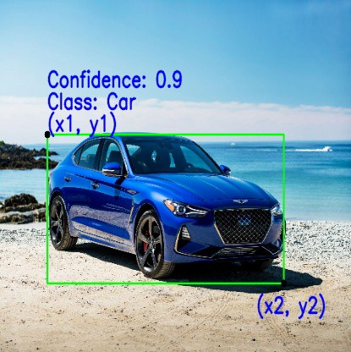
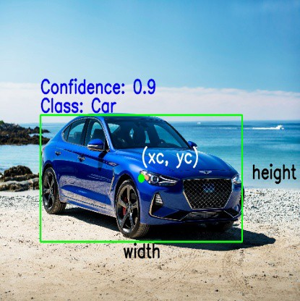
Bounding box specified with respect to its top left and bottom right points
Bounding box specified with respect to its center coordinates

Slide 5
Parameters used to define a bounding box:
Depending on the convention followed, here are the main parameters that specify a bounding box:
Class: What is ithe object inside the box. Eg car, truck, person etc
(x1, y1): Corresponds to the x and y coordinate of the top left corner of the rectangle.
(x2, y2): Corresponds to the x and y coordinate of the bottom right corner of the rectangle.

Slide 6
4. (xc, yc): Corresponds to the x and y coordinate of the center of the bounding box.
5. Width: Represents the width of the bounding box.
6. Height: Represents the height of the bounding box.
7. Confidence: Indicates how likely the object is actually present in that box.
Eg a confidence of 0.9 would indicate that there is a 90% chance that object actually exists in that box.

Slide 7
Converting between the conventions:
We can convert between the different forms of representing the bounding box, depending on our use case.
xc = ( x1 + x2 ) / 2
yc = ( y1 + y2 ) / 2
width = ( x2 — x1)
height = (y2 — y1)

Slide 8
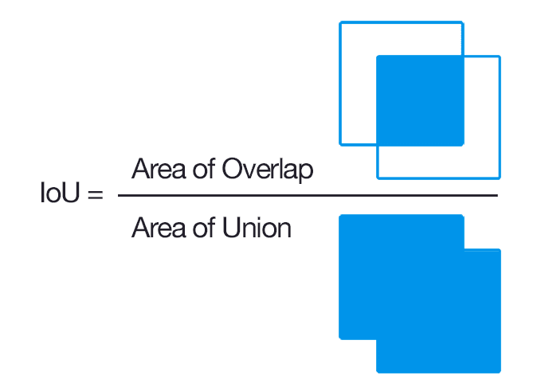
IoU
IOU (Intersection over Union) is a term used to describe the extent of overlap of two boxes. The greater the region of overlap, the greater the IOU.

Slide 9
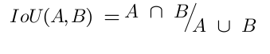
In more mathematical notation it’ll be:
Here A and B are our object masks A intersection B indicates the area which is in the intersection of both of the masks, while A union B indicates the total area of the figures.

Slide 10
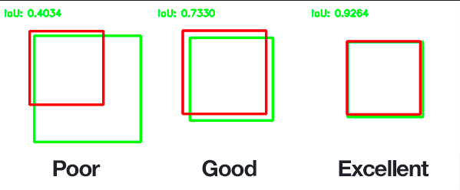
If IoU is close to 1 then we can say that our model perfectly overlaps the object.
If IoU is close to 0 or 0 then we can say that our model didn’t predict the object coordinates at all.

Slide 11
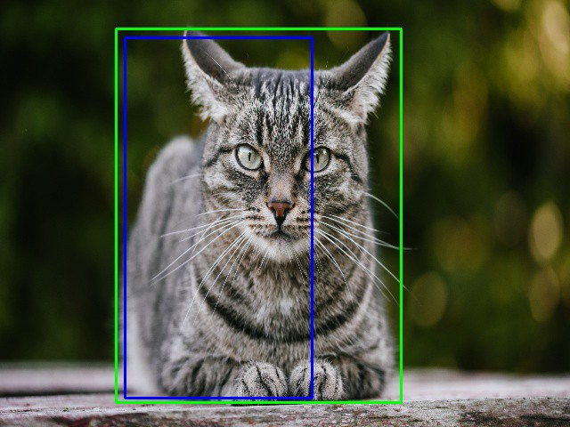
For example in the image below, we have a green box, and a blue box. The green box represents the correct box, and the blue box represents the prediction from the model.
The aim of this model would be to keep improving its prediction, until the blue box and the green box perfectly overlap,
i.e the IOU between the two boxes becomes equal to 1.

Slide 12


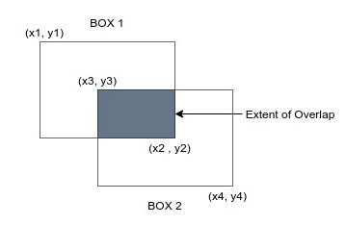
Calculating IoU
Let us assume that box 1 is represented by [x1, y1, x2, y2], and box 2 is represented by [x3, y3, x4, y4].
(We will use this convention later to calculate the areas.)

Slide 13
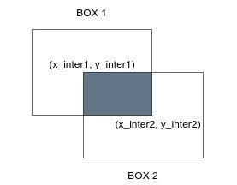
Calculating the area of the intersection
Let us represent the coordinates of the intersected rectangle as [x_inter1, y_inter1, x_inter2, y_inter2 ], to denote the coordinates of the top left, and bottom right of the intersection.

Slide 14
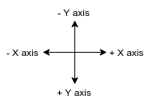
Calculating the area of the intersection
Lets start by defining the reference coordinate system. We use the computer graphics convention of +X axis moving to the right, and +Y axis moving downward.

Slide 15
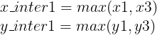
To calculate the top left corner of the intersection, we compare the top left corners of each of the boxes.
We can see from the examples below, that x_inter1 can be found by seeing which box has its top left corner more to the right.
Similarly y_inter1 can be found by seeing which box has its top left corner lower than the other. Mathematically they can be calculated as:

Slide 16
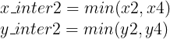
To calculate the bottom right corner of the intersection, we compare the bottom right corners of each of the boxes.
x_inter2 can be found by seeing which box has its bottom right corner more to the left.
Similarly y_inter2 can be found by seeing which box has its bottom right corner higher than the other. Mathematically they can be calculated as:

Slide 17
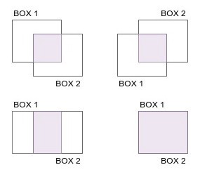
Boxes can intersect in many different ways, or even completely overlap each other.

Slide 18
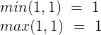
In cases where the boxes overlap perfectly, or have the same value for a particular coordinate, the min or max operation of comparing a value with itself, is simply the value itself.

Slide 19
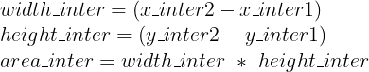
Now that we have the coordinates of the intersection, the area of the intersection is simply the area of the rectangle formed.
In practice we would take the modulus of the width and height, to make sure that even if the orders of the boxes are changed, the width and height would still be positive; i.e if x_inter1>x_inter2 , we would still get a positive value of width.

Slide 20
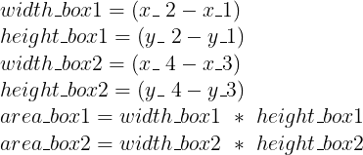
Calculating the area of the union
The union of the boxes is the total area covered by both the boxes.
To find the total area, we first calculate the area of the individual boxes.

Slide 21
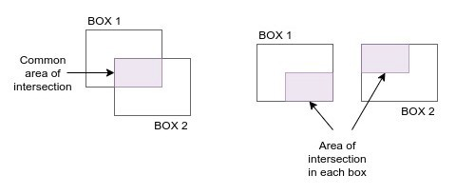
If we look at the total area covered by the two boxes, we see that the portion of the intersection is covered in both the boxes,
i.e the area of the intersection is included in both area_box1 and area_box2.

Slide 22
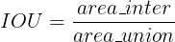
Since we want to account for the common area of intersection only once, we can subtract the area of intersection we calculated, from the total area of the two boxes.
Calculating the IOU

Slide 23
What is the range of values that the IOU can have?
The IOU of two boxes can have any values between 0 and 1.
In case there are 2 boxes that do not intersect, the area of their intersection would be 0, and therefore the IOU would also be 0.
In case there are 2 boxes that completely overlap, the area of the intersection would be equal to the area of their union, and therefore the IOU would be 1.

Slide 24
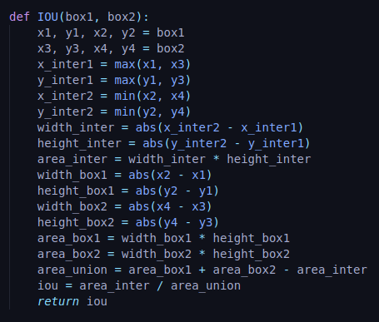
Code to compute IoU in Python
Let's write a function in python to calculate the IOU of the green and the blue box.

Slide 25
The function IOU takes in 2 boxes, box1 and box2 as input. The data in each box is a list containing [x1, y1, x2, y2], which is the top left, and bottom right coordinates.
We find the area of the intersection, followed by the area of the union, as described earlier.
The abs function is an inbuilt function in python to calculate the modulus. This ensures we never end up with a negative width or height.
The IOU returned is a value of type float, that lies between 0 and 1.

Slide 26
NMS
Non max suppression is a technique used mainly in object detection that aims at selecting the best bounding box out of a set of overlapping boxes.

Slide 27
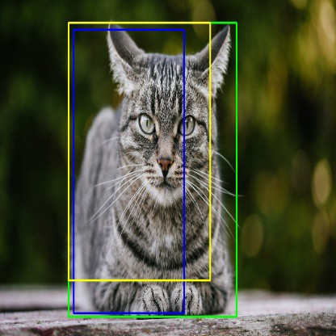
In the following image, the aim of non max suppression would be to remove the yellow, and blue boxes, so that we are left with only the green box.

Slide 28
Explaining the terms used:
The format for each bounding box that we will use is as follows:
bbox = [x1, y1, x2, y2, class, confidence].
Let us assume that for this particular image we have a list 3 bounding boxes;
i.e bbox_list = [blue_box, yellow_box, green_box].
green_box = [x1, y1, x2, y2, ”Cat”, 0.9]
yellow_box = [x5, y5, x6, y6, ”Cat”, 0.75]
blue_box = [x3, y3, x4, y4, ”Cat”, 0.85]

Slide 29
Stage 1 (Initial removal of boxes):
As the first step in NMS, we sort the boxes in descending order of confidences. This gives us:
bbox_list = [green_box, blue_box, yellow_box]
We then define a confidence threshold. Any box that has a confidence below this threshold will be removed. For this example, let us assume a confidence threshold of 0.8. Using this threshold, we would remove the yellow box as its confidence is < 0.8. This leaves us with:
bbox_list = [green_box, blue_box]

Slide 30
Stage 2 (IOU Comparision of boxes):
Since the boxes are in descending order of confidence, we know that the first box in the list has the highest confidence.
We remove this first box from the list and add it to a new list. In our case we would remove the green box, and put it into a new list, say bbox_list_new.
At this stage, we define an additional threshold for IOU. This threshold is used to remove boxes that have a high overlap.
The reasoning behind it is as follows: If two boxes have a significant amount of overlap, and they also belong to the same class, it is highly likely that both the boxes are covering the same object
Since the aim is to have one box per object, we try to remove the box that has a lower confidence.
For our example, let's say that our IOU threshold is 0.5.

Slide 31
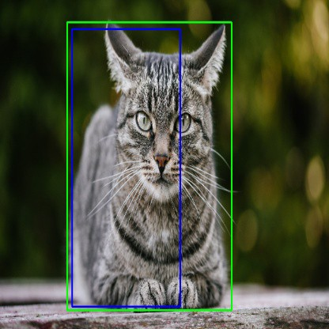
After removing the Yellow box , we are left with the green and blue box.

Slide 32

We now start calculating the IOU of the green box with every remaining box in the bbox_list that also has the same class. In our case we would calculate the IOU of the green box only with the blue box.
If the IOU of the green box and the blue box is greater than the threshold we defined of 0.5, we would remove the blue box, since it has a lower confidence, and also has a significant overlap.
This procedure is repeated for every box in the image, to end up with only unique boxes that also have a high confidence.

Slide 33
Algorithm:
Define a value for Confidence_Threshold, and IOU_Threshold.
Sort the bounding boxes in a descending order of confidence.
Remove boxes that have a confidence < Confidence_Threshold.
Loop over all the remaining boxes, starting first with the box that has highest confidence.
Calculate the IOU of the current box, with every remaining box that belongs to the same class.
If the IOU of the 2 boxes > IOU_Threshold, remove the box with a lower confidence from our list of boxes.
Repeat this operation until we have gone through all the boxes in the list.

Slide 34
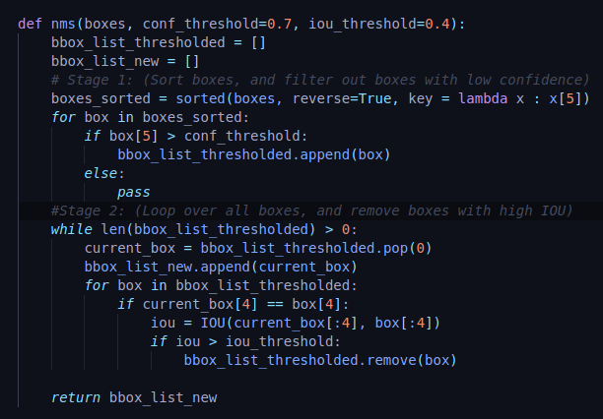
Code:
The code below is the basic function to perform Non Max Suppression.

Slide 35
The function takes as input the list of boxes for the particular image, and a value for confidence threshold, and iou threshold. (We can set default values for them to be 0.7, and 0.4 respectively)
def nms(boxes, conf_threshold=0.7, iou_threshold=0.4):

Slide 36
We create 2 lists called bbox_list_thresholded, and bbox_list_new.
bbox_list_thresholded: Contains the new list of boxes after filtering low confidence boxes
bbox_list_new: Contains the final list of boxes after performing NMS
bbox_list_thresholded = []
bbox_list_new = []

Slide 37
We start Stage 1 by sorting the list of boxes in descending order of confidence, and store the new list in the variable boxes_sorted.
The inbuilt python function called sorted iterates through our list of boxes, and sorts it according to the keywords we specified.
In our case, we specified a keyword reverse=True to sort the list in descending order. The second keyword key specifies the constraint we want to use for sorting.
The lambda function we use provides a mapping that returns the 5th element of each bounding box(confidence).
The sorted function while iterating through each box, would look at the lambda function, which would return the 5th element of the box(confidence), and this would be sorted in a reverse order.
boxes_sorted = sorted(boxes, reverse=True, key = lambda x : x[5])

Slide 38
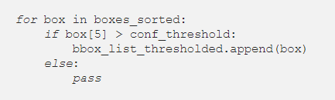
We iterate over all the sorted boxes, and remove the boxes which have a confidence lower than the threshold we set(conf_threshold=0.7)

Slide 39
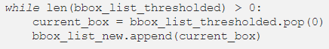
In Stage 2, we loop over all the boxes in the list of thresholded boxes(bbox_list_thresholded) one by one, till the list is emptied.
We start off by removing(pop) the first box from this list(current_box), as it has the highest confidence, and append it to our final list (bbox_list_new).

Slide 40
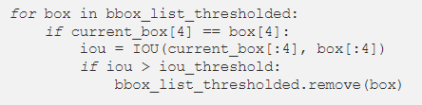
We then iterate over all the remaining boxes in the list bbox_list_thresholded, and check whether they belong to the same class as the current box. (box[4] corresponds to the class)
In case the two boxes belong to the same class, we calculate the IOU between these boxes (we pass box[:4] to the IOU function as it corresponds to the values of (x1, y1, x2, y2), since our IOU function does not require class and confidence).
If the IOU > iou_threshold, we remove the box from the list bbox_list_thresholded, as this box is the one with lower confidence.

Slide 41
We return the updated list of boxes, after the non max supression.
This procedure for non max suppression can be modified according to the application. For example the model YOLOV3 makes use of two sets of confidences as a thresholding measure.

Slide 42
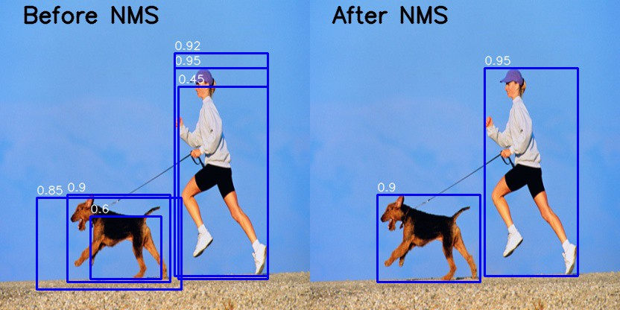
NMS threshold for an image with 2 different classes.

